Slide 1
Myocardial stunning and hibernation
Dr K V Patil

Slide 2
several mechanisms of acute and chronic adaptation to a temporary or sustained reduction in coronary blood flow, known as stunning, hibernation, and ischemic preconditioning
Preserve sufficient energy to protect the structural and functional integrity of the cardiac myocyte

Slide 3
Programmed cell survival has been used to describe the commonality among myocardial stunning, hibernation, and ischemic preconditioning despite their distinct pathophysiology

Slide 4
Stunning: fully reversible dysfunction of the ischemic heart that persists despite the normalization of blood flow.
Myocardial dysfunction due to transient period of ischemia followed by reperfusion (depressed function at rest but preserved perfusion).
Severe ischemia can cause regional loss of electromotive potential without actual cell death (electrical stunning phenomenon)

Slide 5
Hibernating myocardium: adaptive responses of the myocardium to repetitive episodes of ischemia resulting in myocardial hypoperfusion at rest (depressed function and perfusion at rest).

Slide 6
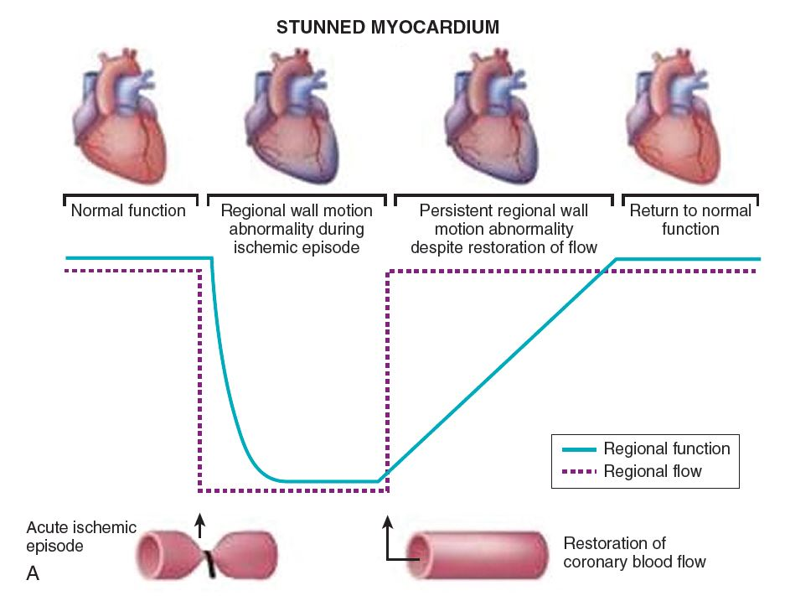

Slide 7
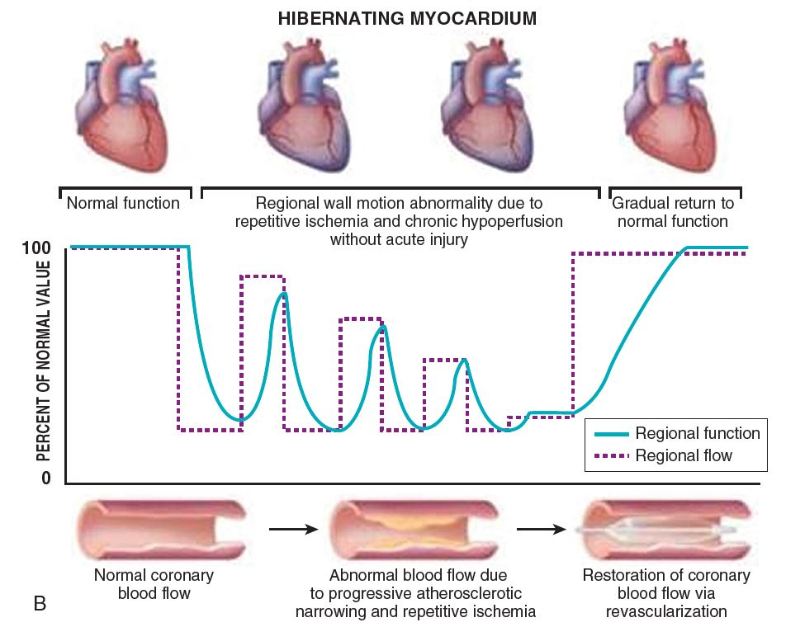

Slide 9
time relationship for recovery of mechanical function, the intramyocardial electrogram and coronary flow after brief periods of regional myocardial ischemia
While regional electrograms return to normal within seconds and the coronary flow debt is repaid rapidly, functional derangement lasts for several hours.
The Journal of Clinical Investigation Volume 56 October 1975@978-985

Slide 10
Coined the term ‘‘myocardial stunning’’
  delayed recovery of regional myocardial contractile function after reperfusion despite the absence of irreversible damage and despite restoration of normal flow.

Slide 11
Contd…
In many patients a positive inotropic intervention, postextrasystolic potentiation or exercise may result in substantial improvement of regional function
Postmortem examination of the hearts of patients with ischemic cardiomyopathy often reveals loss by infarction of only moderate quantities of myocardium.
Horn HR, Teichholz LE, Cohn PF, Herman MV, Gorlin R: Augmentation of left ventricular contraction pattern in coronary artery disease by inotropic catecholamine: the epinephrine ventriculogram. Circulation 49: 1063, 1974
Dyke SH, Cohn RF, Gorlin R, Sonnenblick EH: Detection of residual myocardial function in coronary artery disease using postextrasystolic potentiation. Circulation 50: 694, 1974
Rozanski A, Berman D, Gray R, Diamond G, Raymond M, Prouse JA, Maddahi J, Swan HJC, Matloff J: Preoperative prediction of reversible myocardial asynergy by postexercise radionuclide ventriculography. N Engl J Med 307: 212, 1982

Slide 12
Features of stunning
Normal perfusion.
Depressed myocardial function.
Dissociation of usual relationship between subendocardial flow and function.
Reversible .
Function improves with inotropic agents.

Slide 13
Recovery faster in the subepicardium than in the subendocardium – a non-uniform phenomenon that is most severe in the subendocardium
Both systolic and diastolic function depressed in stunned myocardium - global derangement of the mechanical properties of the heart.

Slide 14
Stunning occurs in a wide variety of settings that differ from one another in several aspects
At experimental level it can occur during
1. Single , completely reversible episode of
regional ischemia (< 20 min )
2. Multiple, completely reversible episodes of
regional ischemia
first occlusion preconditions the myocardium against the next two occlusions so that the overall severity of stunning is the same after one or three occlusions. However, after the third occlusion, this preconditioning effect is negated, and additional occlusions cause a cumulative depression of contractility. A similar paradigm (i.e., a partial preconditioning effect of the initial occlusions against subsequent occlusions) has been observed in conscious rabbits
3. Partly reversible plus partly irreversible
ischemia in vivo ( > 20 min & < 3 hrs)
Subepicardial tissue salvaged by reperfusion may require days or weeks to recover its contractile function

Slide 15
After global ischemia in vitro (isolated heart
preparations)
5. After global ischemia in vivo (cardioplegic arrest)
6. After exercise-induced ischemia

Slide 16
Clinical Relevance
In the clinical setting stunning can occur
1. Brief period of total coronary occlusion:
patients with angina due to spasm
2. Global ischemia after cardiopulmonary bypass.
3. In combination : Subendocardium is infarcted and
overlying subepicardium reversibly injured in MI
4. Following exercise in presence of a flow limiting
stenosis
5. Ischemic bout that is induced by PCI

Slide 17
Factors affecting severity of stunning
Severity and duration of flow deprivation
  close coupling between the degree of myocardial dysfunction after reperfusion and the collateral blood flow during the preceding period of ischemia
Size and location of the ischemic region
  severity of stunning greater in inner layers of the left ventricular wall - most severely ischemic
Myocardial temperature
Loading conditions of the heart

Slide 18
“hypersensitive” myocardium; factors that affect contractile performance in the normal, healthy myocardium have a greater impact on the stunned, convalescent myocardium
BOLLI, R. Oxyradicals in the pathogenesis of myocardial stunning. In: Intrinsic Adaptive Mechanisms During Ischemia and Reperfusion: Preconditioning, Stunning, Hibernation, edited by G. R. Heyndrickx, S. F. Vatner, and W. Wijns. New York: Raven, 1997, p.205–228.

Slide 19
Mechanisms of Stunning
There is no unified view of pathogenesis of stunning
Most plausible hypotheses: represent different facets of the same pathophysiological process
Oxyradical hypothesis : oxidant stress secondary
to the generation of ROS.
Calcium hypothesis : results from disturbance of
cellular calcium homeostasis.

Slide 20
Oxyradical hypothesis
Effect of antioxidants
Stunning by reactive oxygen species [e.g., superoxide anion, hydrogen peroxide, and hydroxyl radical]
In animal experiments, administration of superoxide dismutase (SOD) (which catalyzes the dismutation of superoxide anion to O2 and H2O2) and catalase (which reduces H2O2 to O2 and H2O) significantly enhanced recovery of function after reperfusion
Dimethylthiourea and mercaptopropionyl glycine (MPG) - scavengers of hydroxyl radical → significant and sustained improvement in the function of the stunned myocardium
OH⁻ is an important mediator of postischemic dysfunction
Desferrioxamine attenuated postischemic dysfunction
prevention of the iron-catalyzed formation of OH⁻

Slide 21
Direct evidence for oxyradical hypothesis
spin trap alpha-phenyl-N-tert-butylnitrone (PBN) and electron paramagnetic resonance (EPR) spectroscopy used to detect and measure production of free radicals in a series of animal studies - burst of free radical production was demonstrated immediately after reperfusion
Linear relation between the magnitude of free radical production and the magnitude of ischemic flow reduction
Interventions that alleviate the severity of ischemia early will indirectly attenuate free radical reactions after reflow

Slide 22
aromatic hydroxylation of phenylalanine to specifically interrogate the role of OH⁻ in myocardial stunning
Open chest animal studies : artifacts due to the combined effects of anesthesia, hypothermia, surgical trauma, volume and ionic imbalances, unphysiological conditions, cytokine release, and attending neurohumoral perturbations
But findings replicated in studies in conscious animal

Slide 23
Mechanisms involved
protein denaturation and enzyme inactivation
peroxidation of the polyunsaturated fatty acids contained in cellular membranes → impaired selective membrane permeability
oxyradicals interfere with calcium transport and calcium-stimulated ATPase activity, Na+-Ca2+ exchange and inhibit Na+-K+ATPase activity → sodium overload, with consequent activation of the Na+-Ca2+ exchange activity → cellular calcium overload

Slide 24
decreased responsiveness of myofilaments to calcium by producing selective damage of contractile proteins (oxidation of critical thiol groups)
exposure of myofilaments to superoxide anion has been shown to result in a dose-dependent reduction in maximal calcium-activated force
myofilaments were found to be very sensitive to superoxide –significant force reduction being observed after exposure of <1 min to the superoxide-generating system

Slide 25
Sources of oxyradicals
canine and rat models: xanthine oxidase
Interpretation of the effects of xanthine oxidase inhibitors is complicated by the fact that these agents have major, unanticipated effects to increase the responsiveness of the myofilaments to calcium
activation of the arachidonate cascade
autoxidation of catecholamines and other compounds
activation of various NAD(P)H oxidases
more importantly, damage of the mitochondrial electron transport chain.

Slide 26
Stunning not alleviated by SOD and catalase in prolonged occlusion causing sub-endocardial infarction (but alleviated by cell-permeant antioxidants oxypurinol, N-acetylcysteine and Trolox) and exercise induced stunning

Slide 27
CALCIUM HYPOTHESIS
Calcium plays two distinct roles
  activator of contraction
  agent of injury
Three distinct postulated mechanisms
  decreased responsiveness of the contractile protein machinery to calcium
  calcium overload
  excitation-contraction uncoupling

Slide 28
Role of Calcium in the Pathophysiology of Myocardial Stunning
Cardiac contractile force can be affected by
  intracellular free calcium concentration [Ca2+]i
  contractile protein response to [Ca2+]I
  Loading
    myofilament responsiveness; consists of three components
Maximal force-generating capacity of the myofilaments (at saturating levels of [Ca2+]i)
Sensitivity of myofilaments to calcium (i.e., the range of [Ca2+]I which activates the contractile proteins)
Crossbridge cycling kinetics

Slide 29
Excitation-contraction coupling in stunned myocardium
Kusuoka et al. - depressed maximal calcium activated pressure (the whole heart equivalent of maximal calcium-activated force) in stunned ferret hearts.
KUSUOKA, H., J. K. PORTERFIELD, H. F. WEISMAN, M. L. WEISFELDT, AND E. MARBAN. Pathophysiology and pathogenesis of stunned myocardium. Depressed Ca21 activation of contraction as a consequence of reperfusion-induced cellular calcium overload in ferret hearts. J. Clin. Invest. 79: 950–961, 1987.
Marban and co-workers - measured [Ca2+]i in isolated perfused ferret hearts by NMR spectroscopy - tendency for systolic [Ca2+]i to increase in the stunned hearts despite a 40% drop in developed ventricular pressure
Gao et al. confirmed above findings. simple changes of cross-bridge attachment and detachment rates in a quantitative model of myofilament interaction reproduced contractile dysfunction of stunned myocardium.
decreased maximal calcium activated force? decreased calcium sensitivity? or both?

Slide 30
reflow/proteolysis hypothesis: (Hofmann et al. and Van Eyk et al.) → marked depression of maximal force (45% with 15 min of ischemia) followed by reflow, but no depression with (15 min of) ischemia alone

Slide 31
Mechanism of decreased calcium responsiveness
oxygen radicals → modifications of myofibrillar proteins (e.g., by oxidation of thiol groups)
oxygen radicals → decrease in the content of reduced glutathione and an increase in oxidized glutathione (shown to decrease calcium sensitivity)
alpha-actinin, troponin(Tn) I (partial degradation in stunned myocardium-but not in ischemic nonreperfused samples, prevented by modifications of the reperfusate designed to mitigate calcium overload -- Gao et al.)

Slide 32
Role of Calcium in the Pathogenesis of Myocardial Stunning
Calcium overload after reperfusion
reperfusion injury → calcium overload
Ischemia → intracellular sodium ([Na+]i) accumulates, but Na+-Ca2+ exchange is inhibited by the concomitant acidosis
Kusuoka et al. - isolated ferret hearts - reperfusion with low-calcium solutions markedly attenuates stunning

Slide 33
transient calcium overload, even in the absence of ischemia, leaves behind long-lasting functional sequelae identical to those of stunned myocardium
KITAKAZE, M., H. WEISMAN, AND E. MARBAN. Contractile dysfunctionand ATP depletion after transient calcium overload in perfused ferret hearts. Circulation 77: 685–695, 1988.
striking prevention of stunning when acidosis was induced during the initial minutes of reperfusion
KITAKAZE, M., M. L. WEISFELDT, AND E. MARBAN. Acidosis during early reperfusion prevents myocardial stunning in perfused ferret hearts. J. Clin. Invest. 82: 920–927, 1988.

Slide 34
[Na+]i increases rapidly during ischemia and remains significantly elevated for 8–10 min after reflow
PIKE, M. M., M. KITAKAZE, AND E. MARBAN. 23Na-NMR measurements of intracellular sodium in intact perfused ferret hearts during ischemia and reperfusion. Am. J. Physiol. 259 (Heart Circ. Physiol. 28): H1767—H1773, 1990
complete recovery of pHi within 30 s of reflow
KITAKAZE, M., M. L. WEISFELDT, AND E. MARBAN. Acidosis during early reperfusion prevents myocardial stunning in perfused ferret hearts. J. Clin. Invest. 82: 920–927, 1988.
effects of calcium overload are prevented by the acidosis associated with ischemia, increased concentration of protons effectively competes with calcium for intracellular binding sites

Slide 35
Role of calcium-activated proteases
Calpains
  enzymes that cleave other proteins when cell calcium is elevated
  cause only limited proteolysis - yield large protein fragments - changes caused may not be visualized using conventional histological methods
  calpain I - very effective in digesting TnI and TnT in vitro
  effects could be prevented by coincubation with excess calpastatin - natural inhibitor of calpain I

Slide 36
Yoshida et al.
  activity of calpain I increases after ischemia-reperfusion in isolated rat hearts
  proteolysis of calspectin, a cytoskeletal protein and a specific substrate of calpain I, occurs after periods of ischemia as brief as 10 min followed by 30 min of reperfusion

Slide 38
Junctophilin-2 (JPH2)
  intermembrane-linked protein that maintains the plasmalemma and sarcoplasmic reticulum at a fixed distance to ensure proper excitation–contraction (EC) coupling
  essential for maturation of transverse tubules (TTs) and development of efficient EC coupling in adult cardiac myocytes

Slide 39
August 2018

Slide 40
Therapeutic implications
Reduction of myofilament calcium responsiveness rationalizes the remarkable efficacy of myofilament calcium sensitizers in the treatment of stunned myocardium
Reversibility
  partially degraded contractile proteins replaced by newly synthesized ones to repair the myofilaments
  proteolytic damage may play a role in the late rather than early phase of dysfunction
Therapies begun after the onset of ischemia can still be effective in preventing postischemic dysfunction; as damage occurs mainly during reperfusion

Slide 41
a component of stunning not responsive to antioxidant therapy (no matter how vigorous) or to manipulations to alleviate postreperfusion disturbances in calcium homeostasis - likely to be caused by derangements that occur during ischemia
magnitude of the free radical generation is proportional to the magnitude of the flow deficit => intervention to attenuate the severity of the ischemic injury attenuates the severity of the subsequent reperfusion injury

Slide 46
Preconditioning
Acute preconditioning:
  Brief reversible ischemia preceding a prolonged coronary occlusion reduces myocyte necrosis, a phenomenon termed acute preconditioning
  can be induced pharmacologically using adenosine A1 receptor stimulation as well as various pharmacologic agonists that stimulate protein kinase C or open mitochondrial K-ATP channels

Slide 47
Delayed preconditioning
  persists for up to 4 days
  protein synthesis, with upregulation of the inducible form of NOS (iNOS), COX-2, and opening of the mitochondrial K-ATP channel
Postconditioning
  at reperfusion, ability to engage cardiac protection by producing intermittent ischemia or administering pharmacologic agonists
  activation of reperfusion injury salvage kinase (RISK) pathways - activation of prosurvival kinases, such as Akt and Erk1/2
Derek J. Hausenloy, Andrew Tsang, and Derek M. Yellon. The reperfusion injury salvage kinase pathway: a common target for both ischemic preconditioning and postconditioning.
Trends Cardiovasc Med. 2005 Feb;15(2):69-75

Slide 48
Myocardial hibernation
Downregulation of contractile function, as an adaptation to a reduction in myocardial blood flow, that serves to maintain myocardial integrity and viability during persistent ischemia
“Serum of truly hibernating animals - a substance with opioid-like activity that acts to preserve the myocardial ultrastructure and to improve the functional recovery from ischemia when given to nonhibernating animals”

Slide 49
Diamond et al. - first in 1978 to use the term
1980s, Rahimtoola systematically reviewed the concept

Slide 50
Short-Term Hibernation
In steady-state ischemia, the close matching between perfusion and contraction → reduced regional oxygen consumption and energy utilization
extremely tenuous state, and small increases in the determinants of myocardial oxygen demand → rapid deterioration in function and metabolism

Slide 51
Characteristics of chronic hibernation
Episodic and/or chronically reduced blood flow, which is directly responsible for the decrease in the myocardial contractile function.
Tissue ischemia and resultant remodeling without necrosis
Residual contractile reserve in response to inotropic stimulation (in at least half of clinical cases).
Recovery of contractile function after successful revascularization.

Slide 52
Mechanisms of hibernation
Smart heart hypothesis :
Myocardial metabolism and function are reduced to match concomitant reduction in coronary blood flow which prevents necrosis.
Repetitive stunning hypothesis:
Repetitive episodes of ischemia results in
sustained depression of contractile function.

Slide 53
Genomics of Survival
Maintained viability in hibernation suggests possibility of genomic adaptation.
Major survival genes (antiapoptotic, cytoprotective & growth-promoting genes) and their corresponding proteins are up regulated in hibernating myocardium.

Slide 54
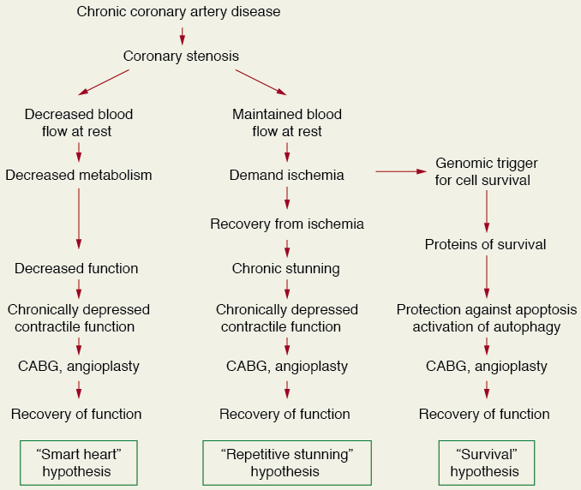

Slide 55
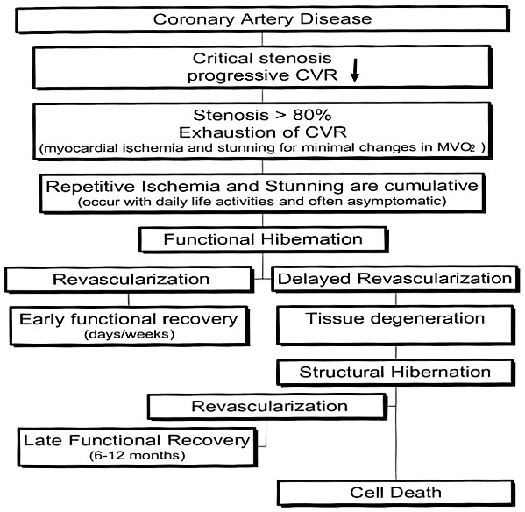
Natural history of hibernation

Slide 56
Histological Features
Loss of contractile proteins without loss of cell volume. Most prominent near nuclear region.
Numerous small mitochondria adjacent to glycogen rich peri-nuclear zone
Loss of sarcoplasmic reticulum – becomes disorganized and loses T tubules
Increased expression of primitive cytoskeleton proteins – titin, cardiotin

Slide 57
Need for understanding these concepts
Widespread use of thrombolytic therapy and percutaneous coronary interventions, increasingly potent antithrombotic agents → significant reductions in mortality and morbidity
Greater number of patients with residual left ventricular (LV) dysfunction undergoing progressive LV remodeling and congestive heart failure.
Ageing population, increasing co-morbidities → greater number of patients with multi-vessel disease, increased LV volumes and variable degrees of regional and/or global systolic dysfunction, isolated diastolic dysfunction

Slide 58
coronary revascularization may lead to symptomatic and prognostic improvement, reverse LV remodeling.
20 to 50 % of pts with chronic ischemic LV dysfunction have significant amount of viable hibernating myocardium.
They improve with revascularization.

Slide 59
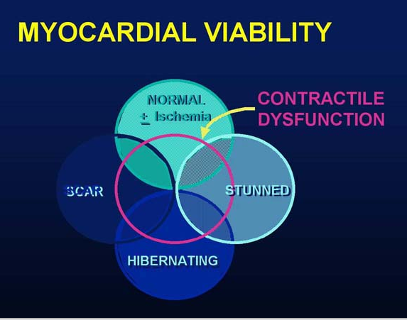

Slide 60
ASSESSMENT OF MYOCARDIAL VIABILITY
ECG : gives little information.
Dobutamine stress echocardiography.
SPECT with thallium-201 or technetium-99 m.
PET
MRI

Slide 61
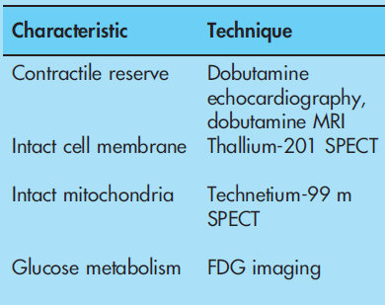
Characteristics of dysfunctional but viable myocardium

Slide 62
ECG
No clear correlation between Q waves on ECG and presence of viability.
Pts with preserved QT dispersion are likely to have viable myocardium.
Pts with high QT dispersion have predominantly non-viable scar tissue.

Slide 63
Dobutamine Stress Echocardiography
Extremely useful tool to document the early and late functional changes at rest.
Hypokinetic or akinetic regions improving during low dose dobutamine infusion (5–10 µg/kg/min) is indicative of viable tissue.
At higher doses (upto 40 µg/kg/min plus atropine) wall motion may improve or diminish, reflecting inducible ischemia.
Biphasic response is highly predictive of recovery of function after revascularization.

Slide 64
Biphasic response-
At lower doses(5–10mg/kg/min)
  improvement in contractile performance
At higher doses (>15mg/kg/min)
  Contractility regresses as the metabolic demand stimulated overwhelms the tissue’s capacity to respond

Slide 65
Stress Echo Interpretation
Interpretation | Rest / Baseline | Low dose stress | Peak & post stress
Normal | Normal | Normal | Hyper dynamic
Ischemic | Normal | Normal / severe ischemia – new RWMA | Decreased
Scar | WMA | No change | No change
Hibernating | WMA | Improved | Worsens
Stunned | WMA | Improved | Improved

Slide 66
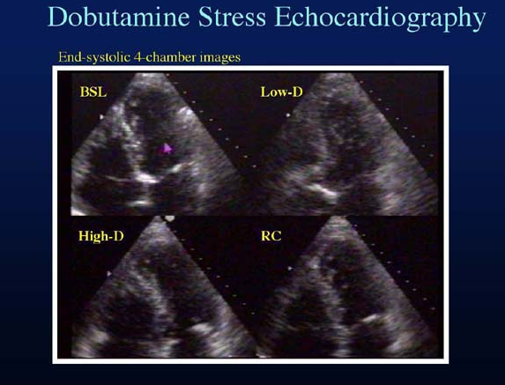

Slide 67
STUDIES-
Nagueh et al studied the transmural myocardial biopsies obtained from patients with hibernating myocardium
→Showed that tissue with >17% fibrosis failed to exhibit contractile reserve when challenged with low-dose dobutamine
Circulation 1999, 100, 490–496.

Slide 68
In a study by Pagano et al , they reported that the diagnostic accuracy of dobutamine-echocardiography was reduced with increasing severity of regional and global LV dysfunction.
That is, the technique appeared to underestimate the extent of viability: 39% of all recovering LV segments failed to exhibit inotropic contractile reserve.
Heart 1998;79:281-288
Wiggers et al studied the functional recovery pre- and 6 months post-revascularization, and showed that low-dose dobutamine failed to identify 45% of the segments that ultimately regained function
Am. Heart. J. 2000, 140, 928–936.

Slide 69
Value of Dobutamine stress echo
Reductions in blood flow that lead to hibernation occurs with a corresponding spectrum of metabolic reserve.
Those regions with greater metabolic reserve will likely retain the ability to respond to an inotropic stimulus while those regions with profoundly reduced flow—just on the threshold of viability—will have no ability to respond.
Such regions appear to be nonviable
dobutamine-echocardiography may be considered an easily accessible tool however with sub-optimal sensitivity

Slide 70
SPECT
Injection of a gamma-emitting radioisotope
Thallium-201 and Technetium Tc 99m–Labelled Tracers - commonly used radionuclides
²⁰¹Th : monovalent cation with biologic properties similar to those of potassium (major intracellular cation in muscle and is virtually absent in scar tissue ) → well-suited radionuclide for differentiation of normal and ischemic myocardium from scarred myocardium.
Initial myocardial uptake early after intravenous injection - proportional to regional blood flow.

Slide 71
Uptake of ²⁰¹Th: an energy-dependent process requiring intact cell membrane integrity ➔ preserved myocyte cellular viability.
Imaging is done
  Immediately following stress, with either exercise or pharmacologically induced coronary hyperemia with dipyridamole or adenosine
  After 3–4 hr redistribution of Th-201

Slide 72
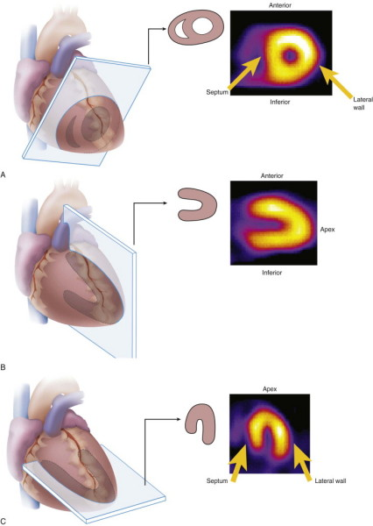
STANDARD SPECT IMAGING DISPLAY

Slide 73
INTERPRETATION
Defects on post-stress images, may “fill in” by the time the rest-redistribution images are acquired, indicating viability.
A defect that persists and appears again on the 3–4 hr images (i.e., a fixed-defect) may be due to:
  markedly reduced regional perfusion
  impaired cellular membrane integrity, inadequate for the active sequestration of the tracer into the cell
  cell death (acute infarction)
  scar tissue.
Thus, fixed-defects on 3– 4 hr redistribution ➔ only severely hypoperfused and not necessarily infarcted tissue

Slide 74
Late redistribution images
  third set of images at 24 hours
  allows for redistribution of the tracer to very-ischemic (yet viable) tissue
  22% of fixed defects (at early redistribution imaging) demonstrate normal Th-201 uptake at later redistribution.
  may indicate a poorly perfused, yet viable region

Slide 75
²⁰¹Th reinjection
may be necessary because redistribution depends on the continued delivery of the tracer over the 3–4 hr period.
blood concentration of Tl- 201 decreases to a great extent → insufficient delivery of the tracer → defect may not fill-in during redistribution imaging
second injection of thallium with delayed imaging → greatest opportunity to sequester thallium.

Slide 76
^{99m}Tc-sestamibi and tetrofosmin
Lipophilic molecule - intracellular retention requires intact mitochondrial function
Do not share the redistribution properties of ²⁰¹Th
Characteristics for predicting improvement in regional function after revascularization appear to be similar

Slide 78
PET
Glucose utilization is evaluated with FDG and regional perfusion assessed with N13-ammonia, rubidium-82, or O15- labeled water.
FDG - transported into the cell by the same sarcolemmal carrier as glucose - phosphorylated to FDG-6-phosphate by the enzyme, hexokinase.
Unidirectional reaction - intracellular accumulation of FDG-6-phosphate.
FDG does not undergo further metabolism - uptake is proportional to the overall rate of trans-sarcolemmal transport and hexokinase phosphorylation

Slide 79
fatty acid oxidation stops shortly after the onset of severe ischemia and ischemic myocytes will derive energy from stored glycogen through anaerobic glycolysis.
After glycogen stores have been depleted, the ischemic myocyte efficiently use circulating glucose.
Under conditions of extremely diminished glucose delivery, sarcolemmal glucose transporters are up-regulated to allow for increased uptake of this substrate.

Slide 80
no uptake of glucose by infarcted myocardium—which is metabolically inert—nonviable myocardium will appear as a region of low-FDG concentration in such images
areas of reversibly injured myocardium - glucose utilization is normal and even above normal
stunned or hibernating myocardium may be indistinguishable from normal tissue

Slide 81
PET perfusion imaging
¹³NH3 and H2¹⁵O
  Initial uptake proportional to myocardial blood flow - retention of 13NH3 depends on the metabolic integrity - late-distribution ¹³NH3 PET images - useful in the assessment of myocardial viability
  Exercise stress can be used

Slide 82
82Rb→ does not need a cyclotron facility
  Late-distribution 82Rb images reflect myocardial viability as the successful uptake of 82Rb depends on an intact myocyte membrane (a functional Na/K ATPase pump)
  Pharmacological stress needed

Slide 83
The Combined Perfusion/Metabolism PET
Long been considered the gold-standard for the identification of hibernating myocardium.
Low perfusion reserve by 13NH3 despite normal FDG uptake - highly predictive of both functional recovery and survival post revascularization.

Slide 84
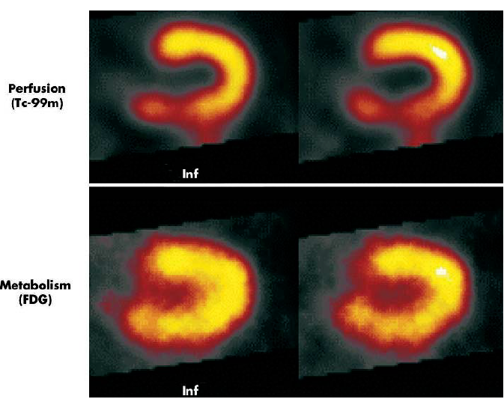

Slide 85
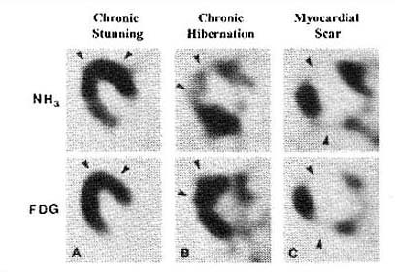

Slide 86
SPECT VS FDG PET
Brunken et al - a comparison of tomographic thallium images with PET images- 47% of the irreversible thallium defects identified as viable on PET images
Circulation. Nov 1992;86(5):1357-69.
Tamaki et al confirmed these findings in 2 comparative studies of SPECT and PET - 38-42% of the irreversible thallium defects had enhanced FDG uptake suggestive of viable myocardium.
Am J Cardiol. Oct 15 1989;64(14):860-5

Slide 87
Magnetic resonance imaging
Three techniques:
Resting MRI to measure end diastolic wall thickness → < 6 mm represents transmural scar.
Dobutamine MRI to evaluate contractile reserve. Increased resolution of MRI avoid subjective variation of echo. Sensitivity of 89% & specificity of 94% to predict improvement after revascularization.
Contrast enhanced MRI to detect extent and transmurality of scar tissue. Can detect subendocardial scar.

Slide 88
Contractile reserve (DS MRI)
Compared to SPECT with both thallium and Tc sestamibi DS MRI is less sensitive but more specific with respect to recovery of contractile function after revascularisation
Sensitivity / Specificity :
  50 / 81% for MRI
  76 and 44% for SPECT thallium
  66 and 49% for SPECT Tc
Compared to PET (gold standard), sensitivity and specificity of dobutamine MRI for the diagnosis of myocardial viability - 81 and 95%.

Slide 89
DE MRI
Allows direct or indirect assessment of viability
Infarct characterization
In a study, presence of Microvascular obstruction, Increased LVEDV and Impaired LVEF in MRI are found to be independent predictors of adverse events.
Three patterns of enhanced signal hyperintensity:
1) Early hypointensity → No late hyperintensity (hypo),
2) early Hyperintensity → late hyperintensity (hyper);
3)early hypointensity → late hyperintensity (comb).

Slide 90
Type I pattern (hypo)
Indicated diffuse microvascular damage
Severe myocardial damage / Myocardial necrosis
Poor functional recovery after revascularisation

Slide 91
Recovery after Revasc. Depends on transmural extension
Highly probable < 25%,
intermediate 25 - 75%,
Very low / null > 75%
Hyperintensities restricted to Subendocardial area will recover contractility better

Slide 92
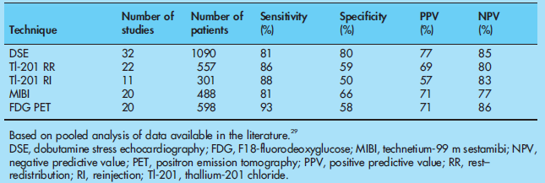
Accuracy of non-invasive techniques to assess myocardial viability

Slide 93
Impact of Revascularization on LV Function
Studies shows LV ejection fraction improves significantly (ie ≥ 5%) after revascularization in 60% of patients (range 38% to 88%).
To predict 5% improvement in LVEF, at least 25% of LV should be viable using DSE and ≈38% using conventional nuclear medicine and PET.
In dyskinetic and akinetic segments, absence of scar or a transmural extension of scar of <25% have PPV of 88% and NPV 89% for functional recovery.

Slide 94
Treatment and Survival Rates
Meta-analysis that pooled data of 3,088 pts from 24 studies demonstrated improved survival after revascularization in pts with hibernation.
Revascularization resulted in 79.6% reduction in mortality (16% vs 3.2%)
In absence of hibernation, no significant difference in mortality with revascularization (7.7% vs 6.2%).

Slide 97
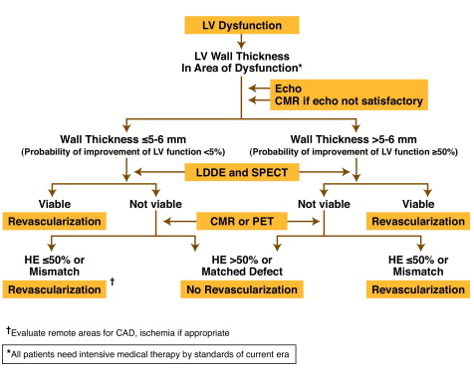

Slide 98
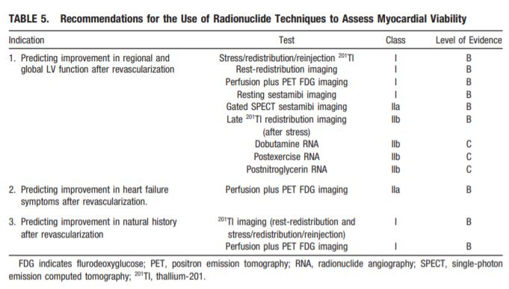

Slide 99
THANK YOU

